Slide 1
Dump and Load Workshop
Tom Bascom, Paul Koufalis; White Star Software
Abstract: A long time ago, in a galaxy far, far away -- dump and load used to be so simple: "Admin - Dump - Data"; wait a few hours (or days); "Admin - Load - Data"; wait a few more hours (or days). But it turned out people didn't like being down for a week to do a D&L, so over the years the Engine Crew has been nice enough to add a lot of new toys to make the process faster. These new options have reduced D&L times dramatically, but sometimes at the cost of increased complexity. But you don't care about complexity!
You want it FAST!!!

Slide 2

Dump and Load Workshop
Tom Bascom, Paul Koufalis White Star Software tom@wss.com pk@wss.com

Slide 3
A Few Words about the Speakers
Notes:
I have been working with Progress since 1987
… and today I am both President of DBAppraise;
The remote database management service…
where we simplify the job of managing and monitoring the worlds best business applications;
and Vice President of White Star Software;
where we offer expert consulting services covering all aspects of Progress and OpenEdge.

Slide 4
A Few Words about the Speakers
Really?
Notes:
I have been working with Progress since 1987
… and today I am both President of DBAppraise;
The remote database management service…
where we simplify the job of managing and monitoring the worlds best business applications;
and Vice President of White Star Software;
where we offer expert consulting services covering all aspects of Progress and OpenEdge.

Slide 5

A Few Words about the Speakers
Really?
If you haven’t figured out who we are by now there is no hope of ever making a sale…
Notes:
I have been working with Progress since 1987
… and today I am both President of DBAppraise;
The remote database management service…
where we simplify the job of managing and monitoring the worlds best business applications;
and Vice President of White Star Software;
where we offer expert consulting services covering all aspects of Progress and OpenEdge.

Slide 6
Agenda
We don’t need no steenkin “agenda” slide!

Slide 7

Connecting to The Cloud

Slide 8
Connection requirements
Terminal type = xterm
Minimum window size 160 columns by 48 lines
PuTTY keys etc…

Slide 9
Checking your instance
Login as “prodba”
who –u (you should be the ONLY user logged in…)
ls
df –h
top (“q” to quit, “h” for help)
nmon (“q” to quit, “h” for help)
pro (“quit”, control-x)

Slide 10
AWS Linux Box Configuration
Architecture: x86_64
CPU op-mode(s): 32-bit, 64-bit
Byte Order: Little Endian
CPU(s): 4
On-line CPU(s) list: 0-3
Thread(s) per core: 1
Core(s) per socket: 4
Socket(s): 1
NUMA node(s): 1
Vendor ID: GenuineIntel
CPU family: 6
Model: 63
Model name: Xeon E5-2676 v3 @ 2.40GHz
Stepping: 2
CPU MHz: 2400.066
BogoMIPS: 4800.13
Hypervisor vendor: Xen
Virtualization type: full
L1d cache: 32K
L1i cache: 32K
L2 cache: 256K
L3 cache: 30720K
NUMA node0 CPU(s): 0-3
PageSize: 4KB RAM-Memory Swap-Space High-Memory Low-Memory
Total (MB) 16050.9 0.0 - not in use - not in use
Free (MB) 156.9 0.0
Free Percent 1.0% 0.0%
Linux Kernel Internal Memory (MB)
Cached= 15347.4 Active= 3972.5
Buffers= 133.4 Swapcached= 0.0 Inactive = 11536.4
Dirty = 0.0 Writeback = 0.0 Mapped = 6.5
Slab = 339.0 Commit_AS = 103.5 PageTables= 4.6
Mount Size(GB) Free(GB) Used% FS Type Mount Options Device
────────────────────────────────────────────────────────────────────────────────────
/new 98.31 56.06 42.97% ext4 (rw,relatime,data=ordered) /dev/xvdf
/ 196.74 133.54 32.12% ext4 (rw,noatime,data=ordered) /dev/xvda1
/dl 98.31 93.23 5.16% ext4 (rw,relatime,data=ordered) /dev/xvdg
/dev 7.83 7.83 0.00% devtmpfs (rw,relatime,size=8207188k…) devtmpfs
/dev/shm 7.84 7.84 0.00% tmpfs (rw,relatime) tmpfs

Slide 11

Lab 1

Slide 12
Your first assignment!
Open 3 windows and login, make the windows at least 160 columns by 48 lines
nmon
“c,m,d,5”
clean.sh
dumpall.sh dict
Keep a command prompt handy

Slide 13
Dictionary dump…
┌─────────────────────────────────────────────────────────────────────────────┐
│ Dumping Data. Press CTRL-C to terminate the dump process. │
│ │
│Table Dump File Records │
│─────────────────────────────────────────────────────────────────────────────│
│totd_det /dl/dump/totd_det.d 0│
│tot_mstr /dl/dump/tot_mstr.d 0│
│trcs_det /dl/dump/trcs_det.d 0│
│trgl_det /dl/dump/trgl_det.d 2000000│
│trld_det /dl/dump/trld_det.d 0│
│trl_mstr /dl/dump/trl_mstr.d 0│
│trq_mstr /dl/dump/trq_mstr.d 0│
│tr_hist /dl/dump/tr_hist.d Dumping │

Slide 14
Dictionary Dump…
./wshop.dump00.sh start: Fri Feb 16 14:07:07 UTC 2018 Current: Fri Feb 16 01:07:57 UTC 2018
./wshop.dump00.sh end: Fri Feb 16 14:08:53 UTC 2018
dumping: 1
loading: 0
staged: 3
archived: 0
Filesystem Size Used Avail Use% Mounted on
/dev/xvda1 197G 64G 134G 33% /
/dev/xvdf 99G 32G 63G 34% /new
/dev/xvdg 99G 25G 70G 26% /dl
4.0K /dl/arc
1.0G /dl/stage
4.0G /dl/dump
4.0K /dl/load
7.0M /dl/log
5.0G /dl

Slide 15
And now we wait…
… and wait
… and wait

Slide 16
Why do we dump & load?
(audience survey)

Slide 17
Why do we dump & load?
To migrate between platforms
To upgrade Progress
To repair corruption
To “improve performance”
To change storage area configuration
To defragment or improve “scatter”
To fix a “long rm chain” problem
Because it is February

Slide 18
Dump & Load Challenges
Technical knowledge
Getting permission for an outage
Inadequate test systems
Inadequate IO subsystems
Disk space
Performance
Time!

Slide 19
Known Workshop Challenges
AWS performance is “inconsistent” at best
Network connectivity is always an “adventure” – no matter what the hotel says
Not everyone is familiar with Linux and command lines
Limited time – we can’t do *everything* ☹

Slide 20
Some Dump & Load Methods and Options
Dictionary
4GL BUFFER-COPY
Binary
Replication triggers (or CDC)
Table partitioning / 4GL
Incremental by storage area

Slide 21
What are we going to do today?
Parallel binary dump with an overlapping binary load and an idxbuild all
This means that we will run multiple processes at the same time
(not really the same as “threads” even though we sometimes say that)
And we will start the load “phase” while the dump is still running i.e. “overlapping”

Slide 22
Some stuff we won’t do today
Users
Security setup
SQL users and views
Sequence values
Auditing
Multi-tenancy
Table partitioning
Transparent data encryption

Slide 23
Binary Dump & Load
“Binary” refers to the record format – not the blocks
It is portable between all Progress platforms regardless of
OS; Windows, Linux, AIX, HPUX and even ElliSUN
“bitness”; 32 or 64 – doesn’t matter
Byte order; big-endian vs little-endian – it’s all the same
Target block size, rows per block or storage area config
.bd files are portable upward across Progress/Openedge versions
Not so portable going backward
Binary dump & load is almost always the fastest option

Slide 24

Discussion

Slide 25
Discussion Points
How far did everyone get?
Note nmon activity highlights

Slide 26
Dump Scripts

Slide 27
bin/dlenv – part 1
#!/bin/sh
#
# dlenv - common environment for dl scripts
DB=wshop
SRCDIR=/old
TGTDIR=/new
DL=/dl # shared directory for the dump & load files
DUMPDIR=${DL}/dump
STGDIR=${DL}/stage
LOADDIR=${DL}/load
DL_LGDIR=${DL}/log
ARCDIR=${DL}/arc
export DB DL DUMPOPT DUMPDIR STGDIR LOADDIR DL_LGDIR ARCDIR TGTDIR
mkdir ${DL} ${DUMPDIR} ${STGDIR} ${LOADDIR} ${DL_LGDIR} ${ARCDIR} ${TGTDIR} 2>/dev/null

Slide 28
bin/dlenv – part 2
dumptable() {
date > ${DL_LGDIR}/${1}.dump.log 2>&1
if [ ! -z "${2}" ] # if an index number is passed use the -index option
then
echo _proutil ${DUMPOPT} ${SRCDIR}/${DB} -C dump ${1} ${DUMPDIR} -index ${2} >> ${DL_LGDIR}/${1}.dump.log 2>&1
_proutil ${DUMPOPT} ${SRCDIR}/${DB} -C dump ${1} ${DUMPDIR} -index ${2} >> ${DL_LGDIR}/${1}.dump.log 2>&1
else
echo _proutil ${DUMPOPT} ${SRCDIR}/${DB} -C dump ${1} ${DUMPDIR} >> ${DL_LGDIR}/${1}.dump.log 2>&1
_proutil ${DUMPOPT} ${SRCDIR}/${DB} -C dump ${1} ${DUMPDIR} >> ${DL_LGDIR}/${1}.dump.log 2>&1
fi
echo mv ${DUMPDIR}/${1}.bd ${STGDIR} >> ${DL_LGDIR}/${1}.dump.log 2>&1
mv ${DUMPDIR}/${1}.bd ${STGDIR} >> ${DL_LGDIR}/${1}.dump.log 2>&1
date >> ${DL_LGDIR}/${1}.dump.log 2>&1
}

Slide 29
Critical Detail Alert!
The “mv” command (aka “rename”) is “atomic” within a filesystem
Moving a file from one directory to another is instantaneous
This makes for a very simple way to coordinate multiple processes that want to operate on a file in sequence:
mv ${DUMPDIR}/${1}.bd ${STGDIR} >> ${DL_LGDIR}/${1}.dump.log 2>&1

Slide 30
bin/dumpall.sh
#!/bin/sh
#
. ${HOME}/bin/dlenv
rm -f ${DL_LGDIR}/dump.complete
if [ ! -d ${1} ]
then
echo "${1} is not a valid dump directory"
exit
fi
${HOME}/bin/dumpallx.sh ${1} &
${HOME}/bin/dlmon.sh ${1}

Slide 31
bin/dumpallx.sh
#!/bin/sh
#
. ${HOME}/bin/dlenv
for SCRIPT in ${1}/*dump0*.sh
do
echo ${SCRIPT}
./${SCRIPT} > ${DL_LGDIR}/`basename -s .sh ${SCRIPT}`.log 2>&1 &
done
# echo "waiting for background tasks to complete..."
wait # waits for all child processes to complete
echo "${0} dump complete" > ${DL_LGDIR}/dump.complete

Slide 32
*/wshop.dump0?.sh
#!/bin/sh
#
. ${HOME}/bin/dlenv
echo "${0} start: " `date` > ${DL_LGDIR}/wshop.dump00.start
dumptable tr_hist # 5.5000 GB
dumptable sod_det # 4.1000 GB
dumptable so_mstr # 3.6000 GB
dumptable gltr_hist # 3.0000 GB
dumptable abs_mstr # 2.7000 GB
# . . .
echo "${0} end: " `date` > ${DL_LGDIR}/wshop.dump00.end

Slide 33
Lab 2

Slide 34
Binary Dump
nmon should still be running
But just in case:
nmon
“c,m,d,5”
clean.sh
dumpall.sh bd1
Keep a command prompt handy

Slide 35
“dlmon” Output
./bd1/wshop.dump00.sh start: Tue Feb 20 20:48:33 UTC 2018 Current: Tue Feb 20 20:52:47 UTC 2018
dumping: 1
-rw-rw-rw- 1 prodba prodba 410M Feb 20 20:52 /dl/dump/tr_hist.bd
loading: 0
staged: 750
archived: 0
root 24992 21783 5 20:49 pts/0 00:00:12 _proutil /old/wshop -C dump tr_hist /dl/dump
Filesystem Size Used Avail Use% Mounted on
devtmpfs 7.9G 64K 7.9G 1% /dev
/dev/xvda1 197G 64G 134G 33% /
/dev/xvdf 99G 38G 57G 40% /new
/dev/xvdg 99G 475M 93G 1% /dl
24K /dl/arc
3.0M /dl/stage
410M /dl/dump
4.0K /dl/tmp
4.0K /dl/load
3.1M /dl/log
4.0K /dl/dl.efs
416M /dl

Slide 36
Timing…
$ cd $DL
$ grep "Feb 22" log/tr_hist.dump.log
Or…
$ howlong.sh tr_hist
Tue Feb 20 20:49:15 UTC 2018
Tue Feb 20 20:56:07 UTC 2018

Slide 37
Discussion

Slide 38
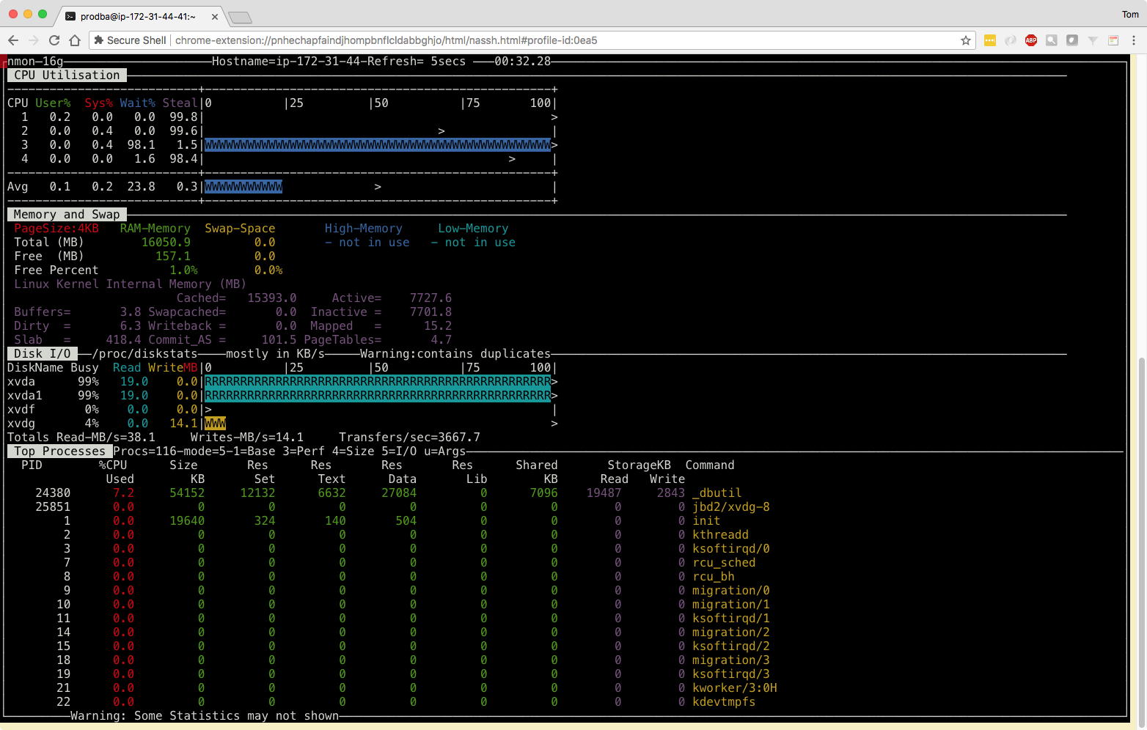
Where do we see bottlenecks?
CPU 3
/dev/xvda
/dev/xvdg
Memory

Slide 39
Where do we see bottlenecks?
CPU 3
/dev/xvda
/dev/xvdg
Memory

Slide 40
What can we do about them?
More CPU?
More RAM?
More disk space?

Slide 41
What can we do about them?
More CPU?
More RAM?
More disk space? (trick question…)
More disk IO ops?
Fewer DB IO ops?

Slide 42
Some Options
Purge data
Multi-thread with:
proutil table –C dump –thread 1 …
Or
proutil table –C dumpspecified
Parallelism – run multiple binary dumps simultaneously
Start a db server and use –B
No server: instead use –RO
Reduce IO through better index selection

Slide 43
TR-HIST (5.5GB data)
Table | Index | idx-num | Unique | _num-comp | Primary | Blocks | SizeMB
tr_hist | tr_trnbr | 1719 | yes | 2 | yes | 18119 | 92
tr_hist | tr_date_trn | 1722 | yes | 3 | no | 22049 | 114
tr_hist | tr_addr_eff | 1720 | no | 3 | no | 21993 | 124
tr_hist | tr_batch | 1721 | no | 2 | no | 18778 | 101
tr_hist | tr_eff_trnbr | 1723 | no | 3 | no | 21650 | 114
tr_hist | tr_nbr_eff | 1724 | no | 3 | no | 23111 | 124
tr_hist | tr_part_eff | 1725 | no | 3 | no | 22335 | 124
tr_hist | tr_part_trn | 1726 | no | 3 | no | 26167 | 137
tr_hist | tr_serial | 1727 | no | 2 | no | 18706 | 101
tr_hist | tr_type | 1728 | no | 3 | no | 22215 | 124
tr_hist | tr_vend_lot | 1729 | no | 2 | no | 18698 | 101
Notes:
tr_trnbr = 1.7% of data size…
Table Index Fields Levels Blocks Size % Util Factor
PUB.tr_hist
tr_addr_eff 1720 3 3 21993 124.2M 72.5 1.5
tr_batch 1721 2 3 18778 101.4M 69.4 1.6
tr_date_trn 1722 3 3 22049 113.6M 66.1 1.7
tr_eff_trnbr 1723 3 3 21650 113.6M 67.4 1.7
tr_nbr_eff 1724 3 3 23111 124.2M 69.0 1.6
tr_part_eff 1725 3 3 22335 124.2M 71.4 1.6
tr_part_trn 1726 3 3 26167 136.5M 67.0 1.7
tr_serial 1727 2 3 18706 101.4M 69.7 1.6
tr_trnbr 1719 2 3 18119 92.1M 65.3 1.7
tr_type 1728 3 3 22215 124.2M 71.8 1.6
tr_vend_lot 1729 2 3 18698 101.4M 69.7 1.6

Slide 44
GLTR-HIST (3GB data)
Table | Index | idx-num | Unique | _num-comp | Primary | Blocks | SizeMB
gltr_hist | gltr_ref | 719 | yes | 4 | yes | 37753 | 204
gltr_hist | gltr_acc_ctr | 720 | no | 7 | no | 71915 | 387
gltr_hist | gltr_addr | 721 | no | 3 | no | 30442 | 165
gltr_hist | gltr_batch | 722 | no | 2 | no | 24259 | 127
gltr_hist | gltr_cc | 723 | no | 2 | no | 24461 | 127
gltr_hist | gltr_ctr | 724 | no | 5 | no | 51009 | 275
gltr_hist | gltr_doctype | 725 | no | 4 | no | 43267 | 234
gltr_hist | gltr_dy_code | 726 | no | 3 | no | 33714 | 184
gltr_hist | gltr_eff_dt | 727 | no | 2 | no | 19628 | 108
gltr_hist | gltr_ent_dt | 728 | no | 5 | no | 53505 | 287
gltr_hist | gltr_export | 729 | no | 3 | no | 28322 | 144
gltr_hist | gltr_ind1 | 730 | no | 7 | no | 72172 | 387
gltr_hist | gltr_ind2 | 731 | no | 4 | no | 44818 | 239
gltr_hist | gltr_project | 732 | no | 7 | no | 72719 | 387
gltr_hist | gltr_sub | 733 | no | 6 | no | 61821 | 329
Notes:
gltr_ref = 6.8% of data size
gltr_eff_dt = 3.6%
Table Index Fields Levels Blocks Size % Util Factor
PUB.gltr_hist
gltr_acc_ctr 720 7 3 71915 386.7M 69.1 1.6
gltr_addr 721 3 3 30442 164.6M 69.5 1.6
gltr_batch 722 2 3 24259 126.7M 67.1 1.7
gltr_cc 723 2 3 24461 126.7M 66.5 1.7
gltr_ctr 724 5 3 51009 274.5M 69.1 1.6
gltr_doctype 725 4 3 43267 233.5M 69.3 1.6
gltr_dy_code 726 3 3 33714 183.8M 70.0 1.6
gltr_eff_dt 727 2 3 19628 107.6M 70.4 1.6
gltr_ent_dt 728 5 3 53505 287.4M 69.0 1.6
gltr_export 729 3 3 28322 144.1M 65.3 1.7
gltr_ind1 730 7 3 72172 386.7M 68.8 1.6
gltr_ind2 731 4 3 44818 239.4M 68.6 1.6
gltr_project 732 7 3 72719 386.7M 68.3 1.6
gltr_ref 719 4 3 37753 203.7M 69.3 1.6
gltr_sub 733 6 3 61821 329.1M 68.4 1.6

Slide 45
How did we do?
How much data have we dumped?

Slide 46
Lab 3

Slide 47
Dump Options
Attribute | Options
Number of Parallel Dump Processes: | 1 / 2 / 4 / 8
Dump Index Selection: | Primary / Smallest / No-Index
Source DB Access: | Multi-User / Single User / -RO
_proutil -thread mode: | No / Yes (requires source db server)

Slide 48
Binary Dump
nmon should still be running
But just in case:
nmon
“c,m,d,5”
clean.sh
dumpall.sh XXX
Keep a command prompt handy

Slide 49
Discussion

Slide 50
Discussion Points
Note nmon activity highlights
Explain dlmon output

Slide 51
Wait a minute! What about the load?
Well we /could/ dive on into that…

Slide 52
Loading

Slide 53
Loading Data
In theory you can run multiple binary loads in parallel so long as they each load into different storage areas
However, a single threaded load with no db server, followed by ”idxbuild all” is usually going to be fastest
The “-r” parameter helps a lot (same benefits as –i but not as dangerous)
If you happen to have awesome hardware and lots of time to test, it can be fun to dig into that.
(Our workshop hardware is not “awesome”)
(And even if it was… we don’t have time)

Slide 54
Potential Load Configuration Options
$HOME/bin/startnew.sh
Possibly interesting db startup options:
-i, -r, -bibufs, -B, -spin, -lruskips, -directio
Other db config options:
bi block and cluster size
db block size (need to rebuild though)
number of APWs

Slide 55
load.sh
Restores a backup of the empty wshop db -- with the .df loaded
After the first load the db will be pre-grown to the proper size
Restoring a backup with just the schema allows you to leverage the pre-grown db
Runs util/loader.p
loader.p waits for .bd files to appear in $DL/stage, when they appear it moves them to $DL/load, fires off a _proutil –C load and then moves the .bd to $DL/arc when done loading that .bd
In this way loading can overlap the dump process – as soon as a .bd file is ready it can be loaded
Runs an idxbuild all
Fires off proutil –C tabanalys for source and target databases
This allows you to compare before and after record counts

Slide 56
util/loader.p
┌──────────────────────────────────────────────────────────────────────────┐
│ │
│ Stage:/dl/stage │
│ Load:/dl/load │
│ Archive:/dl/arc │
│ Logs:/dl/log │
│ │
│ Target DB:/new/wshop │
│ │
└──────────────────────────────────────────────────────────────────────────┘

Slide 57
util/loader.p
Tables Loaded: GB Loaded:
Waiting: 763 Queued: 763
Start GB baseName Status Run Time GB/sec
──────── ───────── ────────────────── ─────────── ─────────── ────────────
13:27:11 5.6156 tr_hist.bd loading...

Slide 58
Lab 4

Slide 59
Dump & Load Options
Attribute | Options
Number of Parallel Dump Processes: | 1 / 2 / 4 / 8
Dump Index Selection: | Primary / Smallest / No-Index
Source DB Access: | Multi-User / Single User / -RO (requires export DLOPT='-RO')
_proutil -thread mode: | No / Yes (requires source db server)
Target DB mode: | Server / No Server

Slide 60
Binary Dump AND Load
nmon should still be running
But just in case:
nmon
“c,m,d,5”
clean.sh
dumpall.sh XXX
load.sh

Slide 61
Discussion

Slide 62
Discussion Points
Note nmon activity highlights
Explain dlmon output

Slide 63
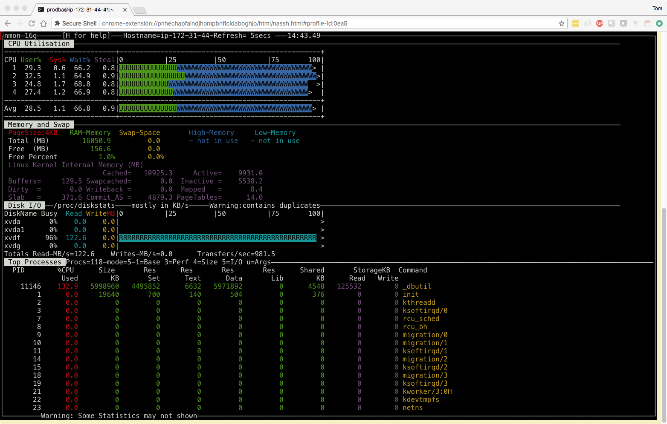
Idxbuild 1

Slide 64
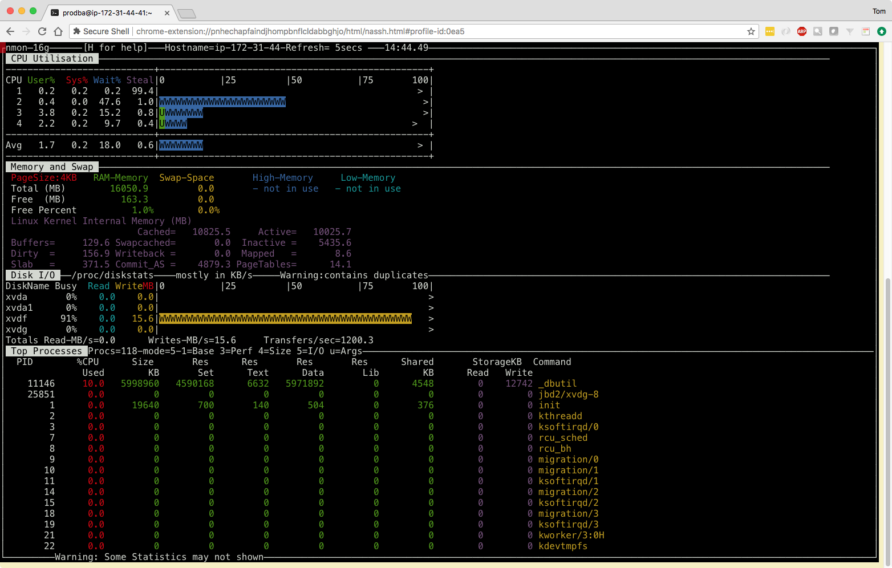
Idxbuild 2

Slide 65
Bonus Material

Slide 66
Build Script

Slide 67
Deciding on your new db structure
Table Summary Report for wshop /old/wshop $PROTOP/rpt/wshop.tbl.rpt
Suggested
Table Name Size Records Reads/sec Upd/sec Avg Rec RPB Ord Current
====================== ============ ========== ========== ======= ======= === === ==============
tr_hist 5905580032 6088826 755 0 969.90 16 0 [TRHIST]
sod_det 4402341478 3000000 707 0 1467.45 8 0 [SO]
so_mstr 3865470566 3182465 750 0 1214.62 8 0 [SO]
gltr_hist 3221225472 9619106 1193 0 334.88 32 0 [GLTRHIST]
abs_mstr 2899102925 3325285 412 0 871.84 16 0 [TRANSACTION]
tx2d_det 1181116006 2521907 313 0 468.34 32 32 [TRANSACTION]
grac_det 837183078 2500000 310 0 334.87 32 32 [GLRPWRTR]
qad_wkfl 1395864371 6000392 744 0 232.63 64 64 [QADWKFL]
aud_det 524288000 2499997 310 0 209.72 64 64 [TRANSACTION]
trgl_det 414187520 2000000 248 0 207.09 64 64 [TRGLDET]
usrl_det 193671987 1500000 186 0 129.11 64 64 [STATIC]
msg_mstr 250819379 2499997 310 0 100.33 128 128 [REFERENCE]
usrgd_det 156028109 1498826 186 0 104.10 128 128 [STATIC]
lgs_mstr 0 0 0 0 ? 256 999 [STATIC]
lc_mstr 0 0 0 0 ? 256 999 [STATIC]
. . .

Slide 68
Deciding on your new db structure
# Proposed new st file for /old/wshop
#
b /new/wshop.b1 f 2048000
b /new/wshop.b2
#
d "Schema Area":6,64 /new/wshop.d1 f 65536
d "Schema Area":6,64 /new/wshop.d2
#
a /new/wshop.a1
a /new/wshop.a2
a /new/wshop.a3
a /new/wshop.a4
. . .
d "unused_dat":90,64;8 /new/wshop_90.d1
d "unused_idx":91,1;8 /new/wshop_91.d1
#
d "misc16_dat":100,16;64 /new/wshop_100.d1
d "misc16_idx":101,1;64 /new/wshop_101.d1
#
d "misc32_dat":102,32;64 /new/wshop_102.d1
d "misc32_idx":103,1;64 /new/wshop_103.d1
#
d "misc64_dat":104,64;64 /new/wshop_104.d1
d "misc64_idx":105,1;64 /new/wshop_105.d1
#
d "misc128_dat":106,128;64 /new/wshop_106.d1
d "misc128_idx":107,1;64 /new/wshop_107.d1
#
d "misc256_dat":108,256;64 /new/wshop_108.d1
d "misc256_idx":109,1;64 /new/wshop_109.d1
. . .
d "tr_hist_dat":110,16;512 /new/wshop_110.d1
d "tr_hist_idx":111,1;64 /new/wshop_111.d1
#
d "sod_det_dat":112,8;512 /new/wshop_112.d1
d "sod_det_idx":113,1;64 /new/wshop_113.d1
#
d "so_mstr_dat":114,8;512 /new/wshop_114.d1
d "so_mstr_idx":115,1;64 /new/wshop_115.d1
#
d "gltr_hist_dat":116,32;512 /new/wshop_116.d1
d "gltr_hist_idx":117,1;64 /new/wshop_117.d1
#
d "abs_mstr_dat":118,16;512 /new/wshop_118.d1
d "abs_mstr_idx":119,1;64 /new/wshop_119.d1

Slide 69
Building the target DB with build.sh
Options to set db, bi and ai block sizes & bi cluster size
prostrct create [–validate]
Enables large files, large keys and puts the schema into B2
Pre-grows the bi file
Loads a .df file and then uses tablemove to shuffle objects into their proper storage areas
Saves the new .df
Makes a backup of the empty database (the schema, but no data)

Slide 70
Lab X

Slide 71
Build a database
Open 3 windows and login, make the windows at least 160 columns by 48 lines
nmon
“c,m,d,5”
clean.sh
build.sh
Keep a command prompt handy

Slide 72
Check the DB
┌──────────────────────────────────────────────────── Storage Areas ────────────────────────────────────────────────────────────────────────┐
│ # BX Area Name Allocated Variable Tot GB Free GB %Allo v %LastX BSZ RPB CSZ #Tbls #Idxs #LOBs #Exts Var? * Max% Bug% │
│ ──────────────────────────────────────────────────────────────────────────────────────────────────────────────────────────────────────── │
│ > 6 B2 Schema Area 0.06 0.00 0.06 0.04 43% 43% 8 64 1 0 0 0 2 yes 0.000% 0.000% │
│ 90 B1 unused_dat 0.00 0.05 0.05 0.00 0% 0% 8 64 8 750 0 0 1 yes 0.000% 0.000% │
│ 91 B1 unused_idx 0.00 0.10 0.10 0.00 0% 0% 8 1 8 0 1684 0 1 yes 0.000% 0.001% │
│ 100 B1 misc16_dat 0.00 0.00 0.00 0.00 0% 0% 8 16 64 0 0 0 1 yes 0.000% 0.000% │
│ 101 B1 misc16_idx 0.00 0.00 0.00 0.00 0% 0% 8 1 64 0 0 0 1 yes 0.000% 0.000% │
│ 102 B1 misc32_dat 0.00 2.01 2.01 0.00 0% 0% 8 32 64 2 0 0 1 yes 0.000% 0.000% │
│ 103 B1 misc32_idx 0.00 1.48 1.48 0.00 0% 0% 8 1 64 0 13 0 1 yes 0.000% 0.009% │
│ 104 B1 misc64_dat 0.00 2.42 2.42 0.00 0% 0% 8 64 64 4 0 0 1 yes 0.000% 0.000% │
│ 105 B1 misc64_idx 0.00 1.21 1.21 0.00 0% 0% 8 1 64 0 13 0 1 yes 0.000% 0.007% │
│ 106 B1 misc128_dat 0.00 0.40 0.40 0.00 0% 0% 8 128 64 2 0 0 1 yes 0.000% 0.000% │
│ 107 B1 misc128_idx 0.00 0.15 0.15 0.00 0% 0% 8 1 64 0 4 0 1 yes 0.000% 0.001% │
│ 108 B1 misc256_dat 0.00 0.00 0.00 0.00 0% 0% 8 256 64 0 0 0 1 yes 0.000% 0.000% │
│ 109 B1 misc256_idx 0.00 0.00 0.00 0.00 0% 0% 8 1 64 0 0 0 1 yes 0.000% 0.000% │
│ 110 B1 tr_hist_dat 0.00 5.82 5.82 0.00 0% 0% 8 16 512 1 0 0 1 yes 0.000% 0.000% │
│ 111 B1 tr_hist_idx 0.00 1.24 1.24 0.00 0% 0% 8 1 64 0 11 0 1 yes 0.000% 0.008% │
│ 112 B1 sod_det_dat 0.00 4.58 4.58 0.00 0% 0% 8 8 512 1 0 0 1 yes 0.000% 0.000% │
│ 113 B1 sod_det_idx 0.00 0.48 0.48 0.00 0% 0% 8 1 64 0 5 0 1 yes 0.000% 0.003% │
│ 114 B1 so_mstr_dat 0.00 4.05 4.05 0.00 0% 0% 8 8 512 1 0 0 1 yes 0.000% 0.000% │
│ 115 B1 so_mstr_idx 0.00 0.82 0.82 0.00 0% 0% 8 1 64 0 10 0 1 yes 0.000% 0.005% │
│ 116 B1 gltr_hist_dat 0.00 3.15 3.15 0.00 0% 0% 8 32 512 1 0 0 1 yes 0.000% 0.000% │
│ 117 B1 gltr_hist_idx 0.00 3.50 3.50 0.00 0% 0% 8 1 64 0 15 0 1 yes 0.000% 0.021% │
│ 118 B1 abs_mstr_dat 0.00 2.82 2.82 0.00 0% 0% 8 16 512 1 0 0 1 yes 0.000% 0.000% │
│ 119 B1 abs_mstr_idx 0.00 0.85 0.85 0.00 0% 0% 8 1 64 0 9 0 1 yes 0.000% 0.005% │
└───────────────────────────────────────────────────────────────────────────────────────────────────────────────────────────────────────────┘

Slide 73
Discussion

Slide 74
Discussion Points
build.sh is fairly fast – it only takes a minute or two
You can keep tweaking it until you have things the way you want them!
REPEATABLE

